Slide 1
Object-Oriented Analysis and Design using JAVA
B.Tech (CSE/IT) 5th SEM
2021-2022
Module -2 : Object Oriented Analysis
Lecture-13 Identifying classes and objects

Slide 2
Introduction
What are objects
Objects combine data and function in a cohesive unit. Every object is uniquely identifiable.
“A discreet entity with a well-defined boundary that encapsulates state and behavior; an instance of a class.”
Objects hide data behind a layer of functions. Attribute values hold an object’s data.
Reference: UML and the Unified Process Practical object-oriented analysis and design-By-Jim Arlow , Neustadt

Slide 3
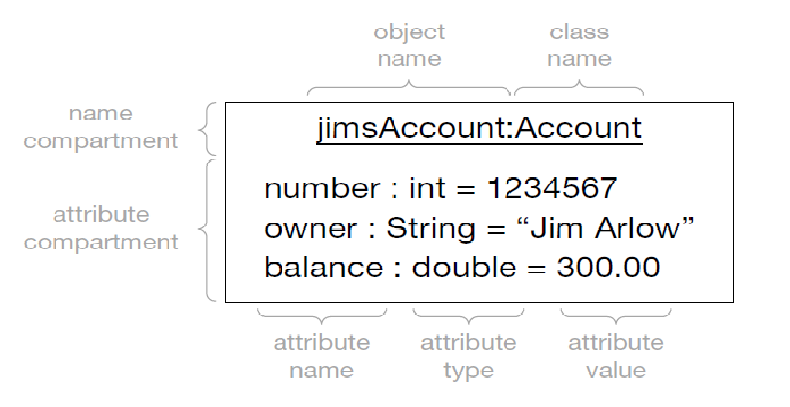
UML notation of object
Objects of the same class have the same operations and
the same attributes, but may have different attribute values.
Reference: UML and the Unified Process Practical object-oriented analysis and design-By-Jim Arlow , Neustadt

Slide 4
What are classes
A class describes the features of a set
of objects. Every object is an instance of exactly one class.
“The descriptor for a set of objects that share the same attributes, operations, methods, relationships, and behavior.”
Finding the right classification scheme
is one of the keys to successful OO analysis..
Reference: UML and the Unified Process Practical object-oriented analysis and design-By-Jim Arlow , Neustadt

Slide 5
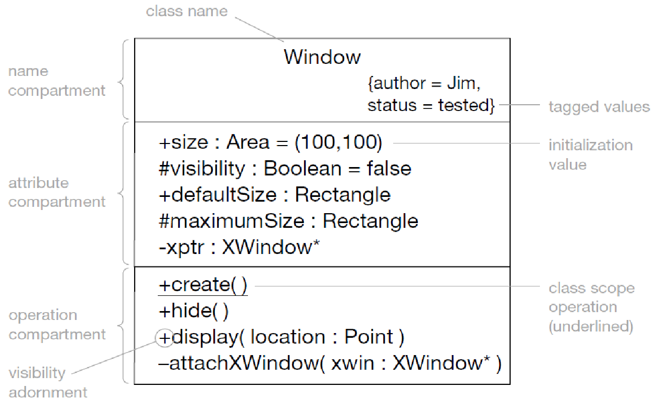
UML notation of class
Reference: UML and the Unified Process Practical object-oriented analysis and design-By-Jim Arlow , Neustadt

Slide 6
Class name is in CamelCase – it begins with an uppercase letter, and then is in mixed upper and lowercase, with each word beginning in uppercase. Special symbols such as punctuation marks, dashes, underscores, ampersands, hashes, and slashes are always avoided..
Name compartment
Avoid abbreviations at all costs. Class names should always reflect the names of real-world entities without abbreviation. For example, FlightSegment is always preferable to FltSgmnt, DepositAccount is always preferable to DpstAccnt
Reference: UML and the Unified Process Practical object-oriented analysis and design-By-Jim Arlow , Neustadt

Slide 7
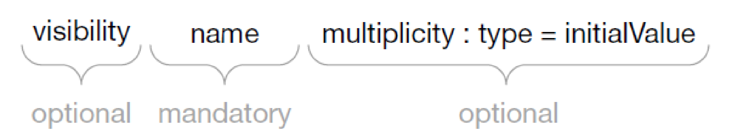
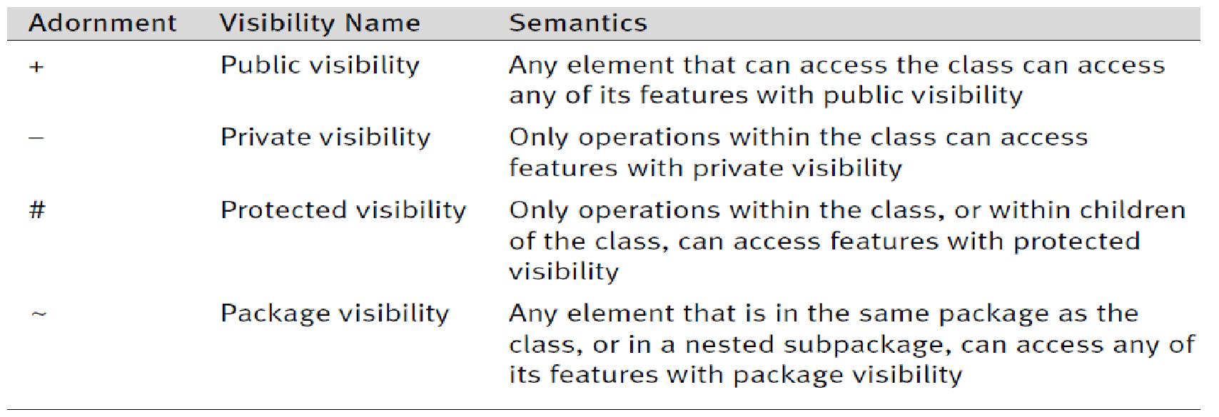
Attribute compartment
The only mandatory part of the UML attribute syntax is the attribute name:
Reference: UML and the Unified Process Practical object-oriented analysis and design-By-Jim Arlow , Neustadt

Slide 8
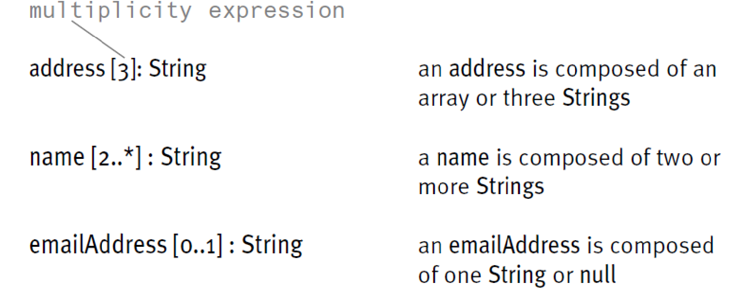
Attribute compartment-multiplicity
The only mandatory part of the UML attribute syntax is the attribute name:
Multiplicity is widely used in design, but may also be used in analysis models as it can provide a concise way to express certain business constraints relating to the “number of things” participating in a relationship.
In fact, multiplicity allows you to model two distinctly different things by using a multiplicity expression
Reference: UML and the Unified Process Practical object-oriented analysis and design-By-Jim Arlow , Neustadt

Slide 9
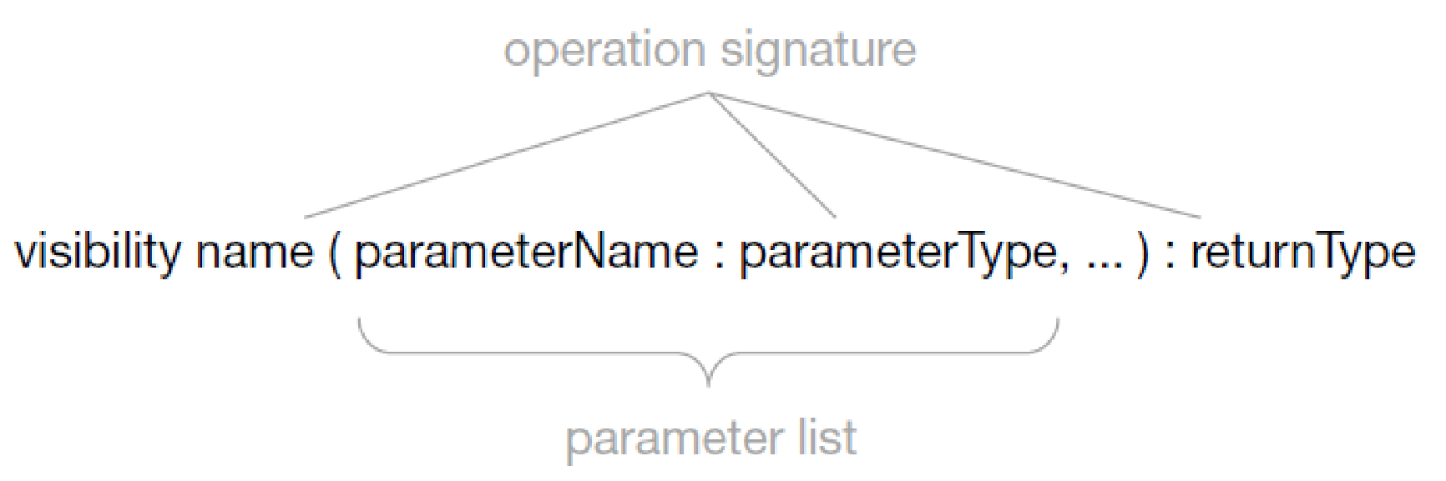
Operation compartment
Operations are functions that are bound to a particular class. As such, they have all of the characteristics of functions:
name;
parameter list;
return type.
The combination of the operation name, types of all the parameters, and the return type is the operation signature. Every operation of a class must have a unique signature, as it is this signature that gives the operation its identity. When a message is sent to an object, the message signature is compared to the operation signatures defined in the object’s class, and if a match is found the appropriate operation is invoked on the object.
Reference: UML and the Unified Process Practical object-oriented analysis and design-By-Jim Arlow , Neustadt

Slide 10
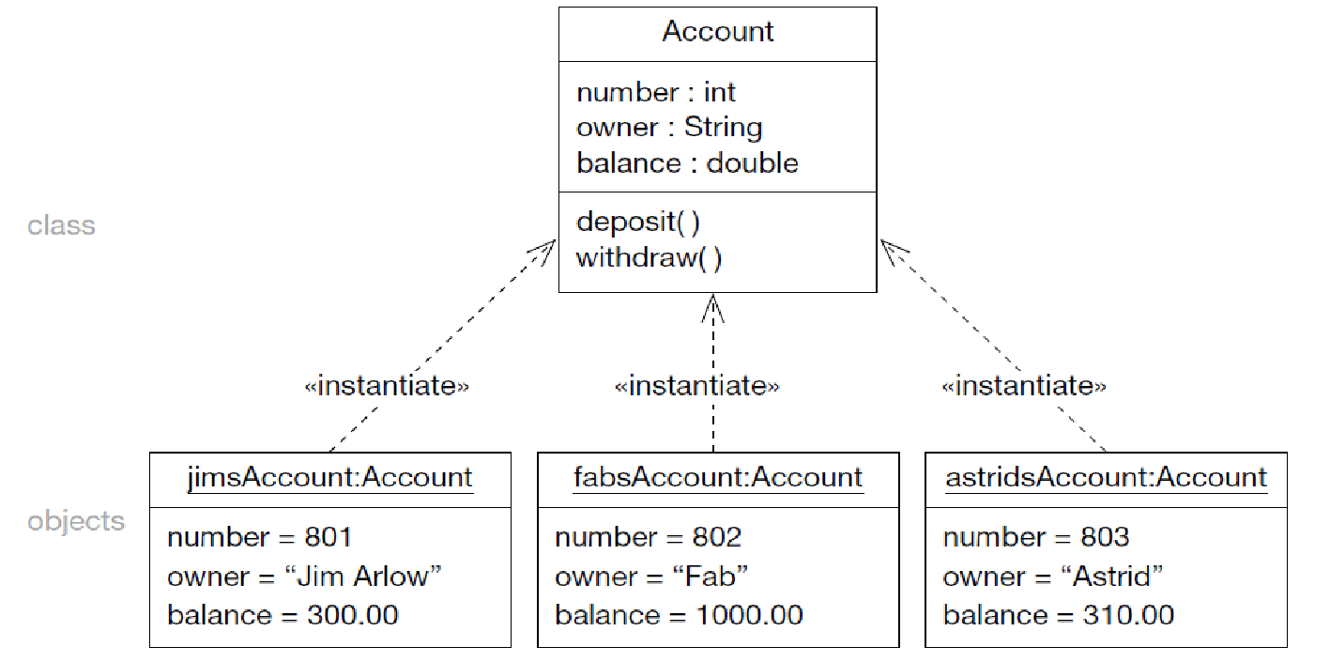
Relationship between classes and objects
The relationship between a class and objects of that class is an «instantiate» Relationship
Reference: UML and the Unified Process Practical object-oriented analysis and design-By-Jim Arlow , Neustadt

Slide 11
Key references
UML and the Unified Process Practical object-oriented analysis and design-By-Jim Arlow , Neustadt

Slide 12
Thank You

